Slide 1
Improve Customer Experience with Top Tasks Audience survey results
February 13, 2018
Gerry McGovern
customercarewords.com

Slide 2
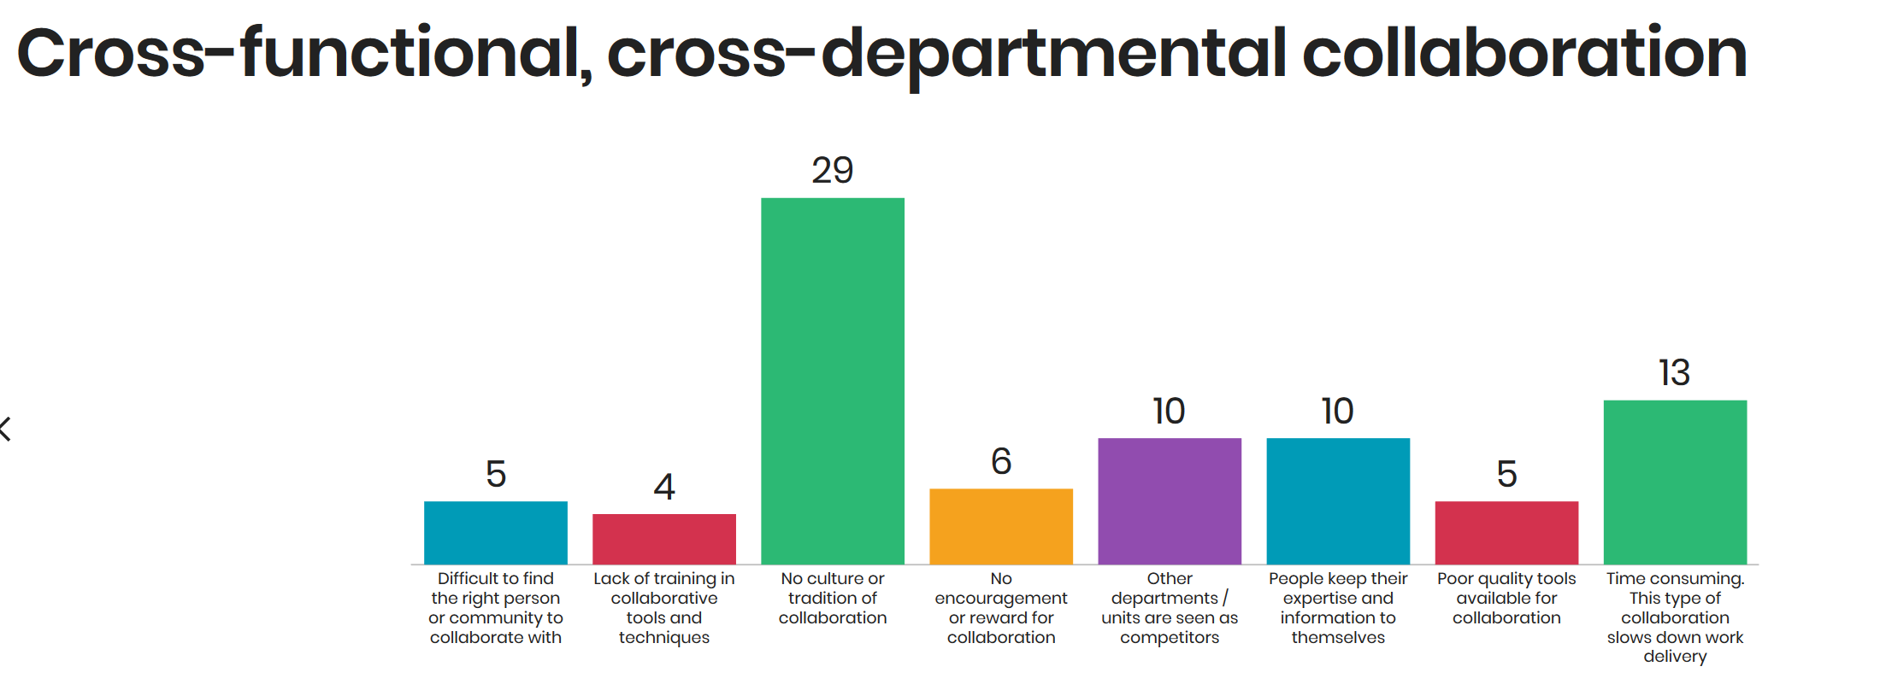
Audience survey

Slide 3
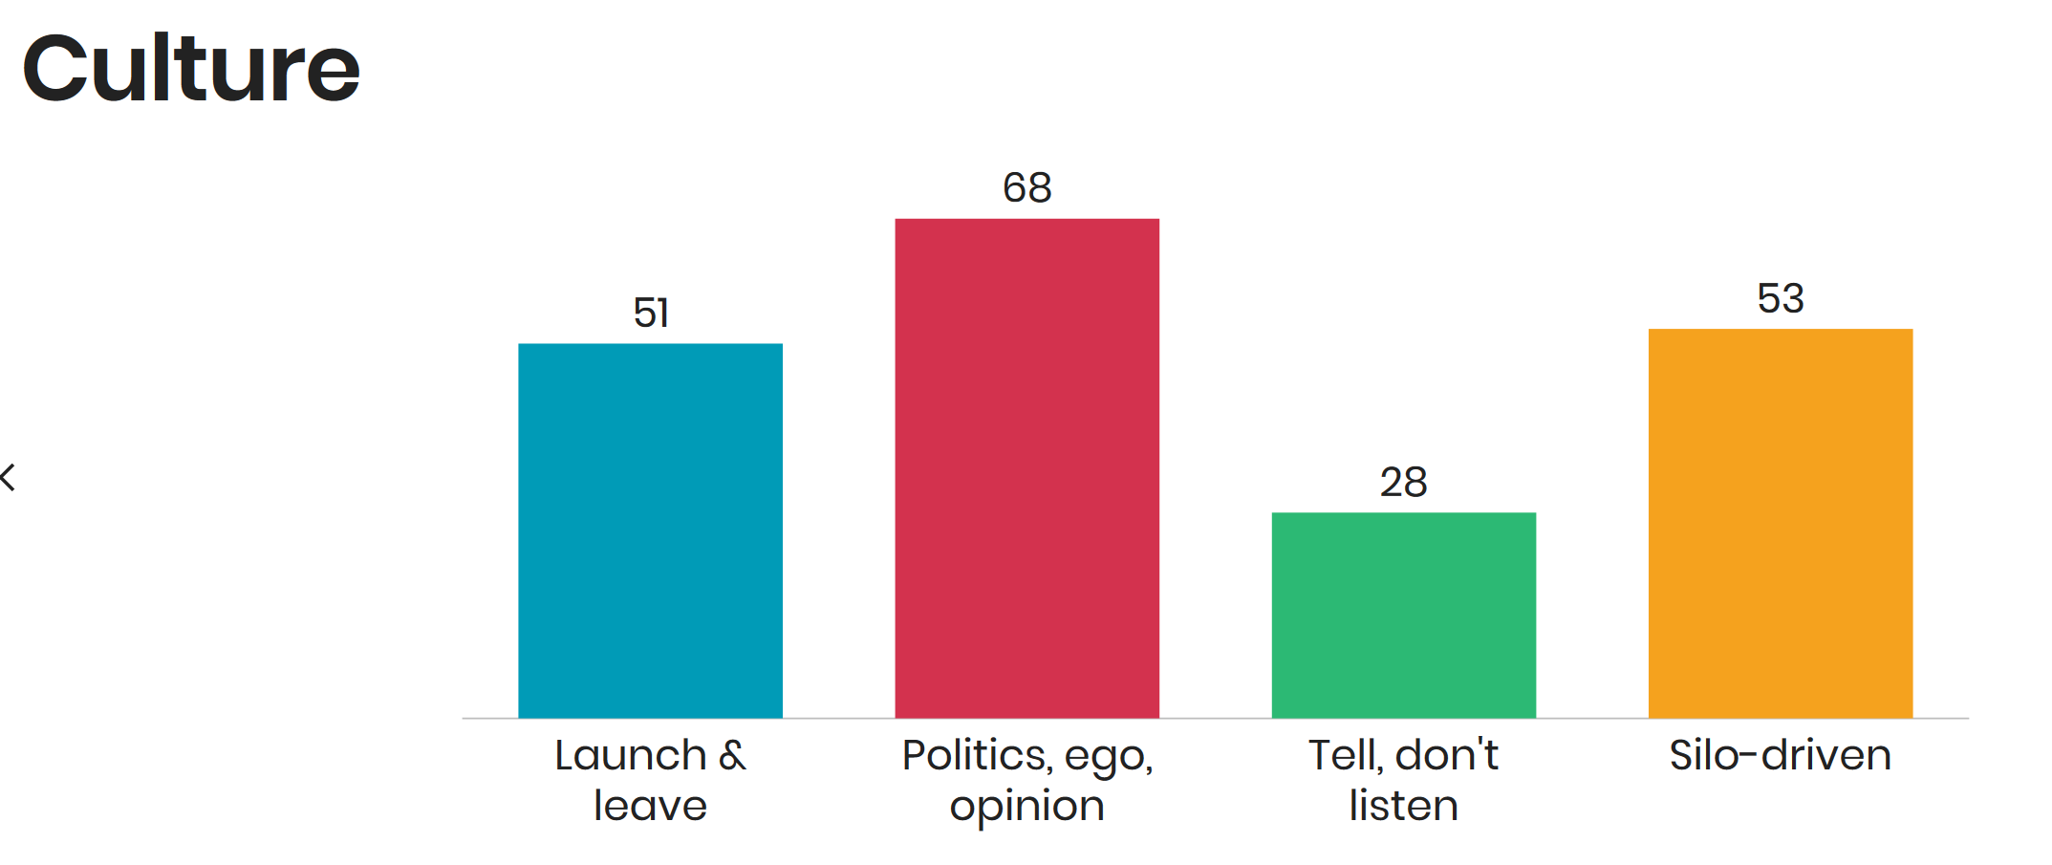
Audience survey

Slide 4
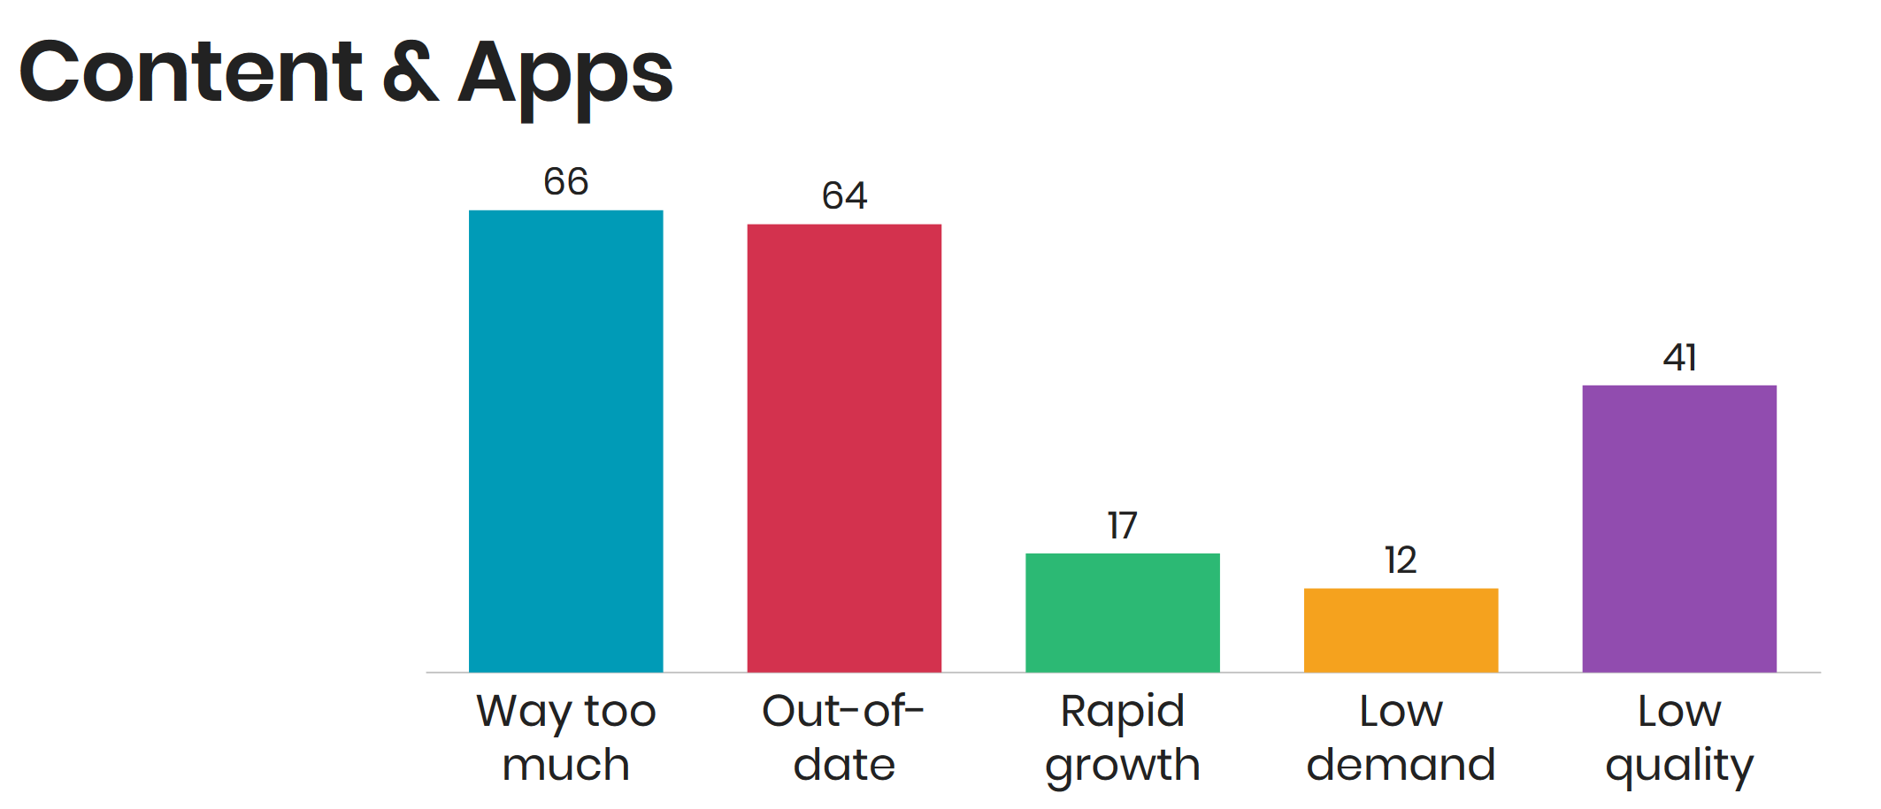
Audience survey

Slide 5
Thank you
WWW.
customercarewords.com
gerry@customercarewords.com
+353 87 238 6136
@gerrymcgovern

